Slide 1
05 - Transport Layer
Sangmyung Univ., 휴먼지능정보공학과

Slide 2
05-1. Overview of
Transport Layer Protocols

Slide 3
Transport layer
The transport layer is responsible for the delivery of a message from one process to another.
The transport layer address is a “service-point address”.
  network layer: logical communication between hosts
  transport layer: logical communication between processes, relies on network layer services

Slide 4
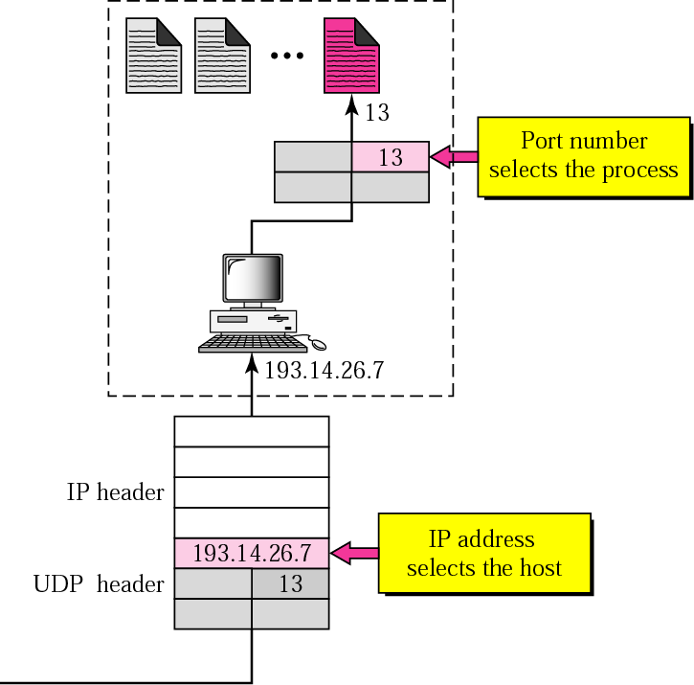
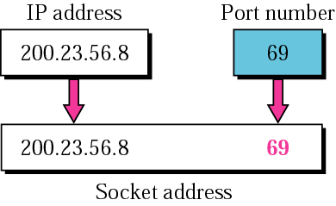

Slide 5
Transport layer (continued)
Starts and stops the connection of the transmission.
  At the transmitter, it is responsible for dividing a message into transportable segments, numbering them and then sending them one by one.
  At the receiver, it is responsible for waiting until all segments have arrived, checking for errors and then processing as a message.

Slide 6
Terminology
Application Message
Max Segment Size: MSS
TCP Segment
TCP hdr
TCP data
IP Packet (or Datagram)
20 bytes
IP hdr
IP data
Ethernet Frame
20 bytes
Ethernet
Ethernet data
14 bytes, Header
Max Transmission Unit: MTU 1500 bytes
4 bytes, Trailer

Slide 7
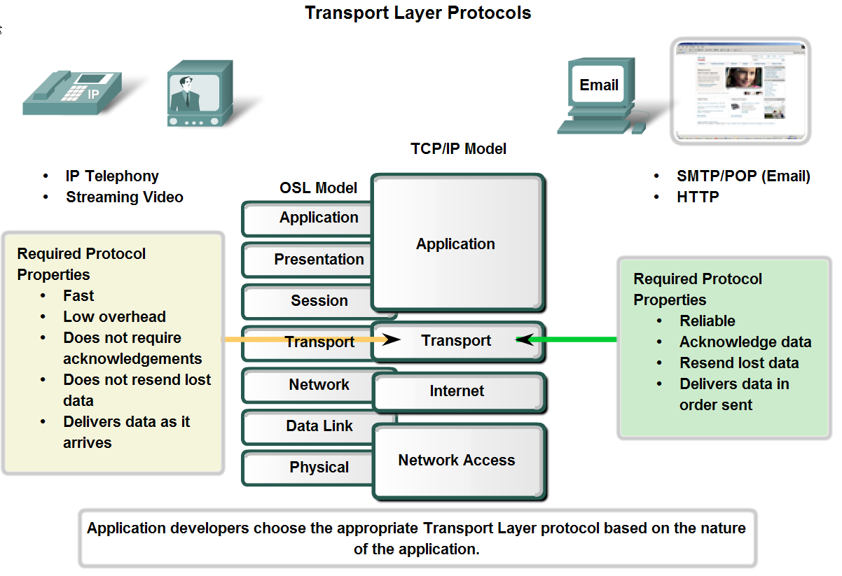

Slide 8
Connection-less Transport Layer Protocol:
UDP
Connection-oriented Transport Layer Protocol:
TCP

Slide 9
Internet transport-layer protocols
reliable, in-order delivery (TCP, Transmission Control Protocol)
  congestion control
  flow control
  connection setup
unreliable, unordered delivery (UDP, User Datagram Protocol)
  extension of “best-effort” IP
services not available:
  delay guarantees
  bandwidth guarantees

Slide 10
05-2. User Datagram Protocol, UDP

Slide 11
UDP: User Datagram Protocol [RFC 768]
“best effort” service, UDP segments may be:
  lost
  delivered out-of-order to app
connectionless:
  no handshaking between UDP sender, receiver
  each UDP segment handled independently of others
UDP used in:
  streaming multimedia apps
    loss tolerant & rate sensitive
  DNS
  SNMP
for a reliable transfer over UDP:
  should add reliability at application layer
  need application-specific error recovery

Slide 12
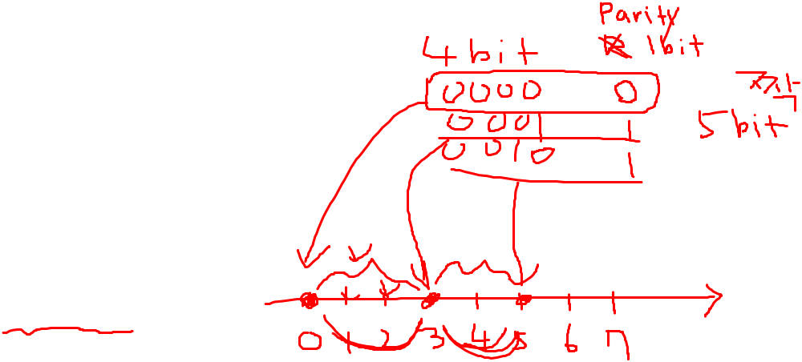
UDP: segment header
length, in bytes of UDP
segment, including header
32 bits
source port #
dest port #
length
checksum
why is there a UDP?
no connection establishment
  which can add delay
simple: no connection state at sender, receiver
small header size
no congestion control: UDP can transfer data as fast as desired
application
data
(payload)
UDP segment format

Slide 13
UDP checksum
Goal: detect “errors” (e.g., flipped bits) in the transmitted segment
sender:
  treat segment, including header fields, as sequence of 16-bit integers
  checksum: addition (one’s complement sum) of segment sequence
  sender puts checksum value into UDP checksum field
receiver:
  compute checksum of received segment
  check if computed checksum equals checksum field value:
    NO - error detected
    YES - no error detected. But there maybe errors

Slide 14
Port Number To Use
Popular applications have well-known ports
  E.g., port 80 for Web and port 25 for e-mail
  See https://www.iana.org/assignments/service-names-port-numbers
Well-known vs. Private ports
  Server has a predefined well-known port (e.g., port 80)
    Between 0 and 1023
  Client picks an unused private port
    Between 49152 and 65535
Uniquely identifying traffic between the hosts by
  Two IP addresses and two port numbers
  Underlying transport protocol (e.g., TCP or UDP)

Slide 15
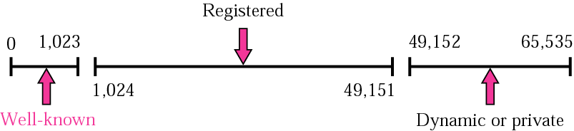
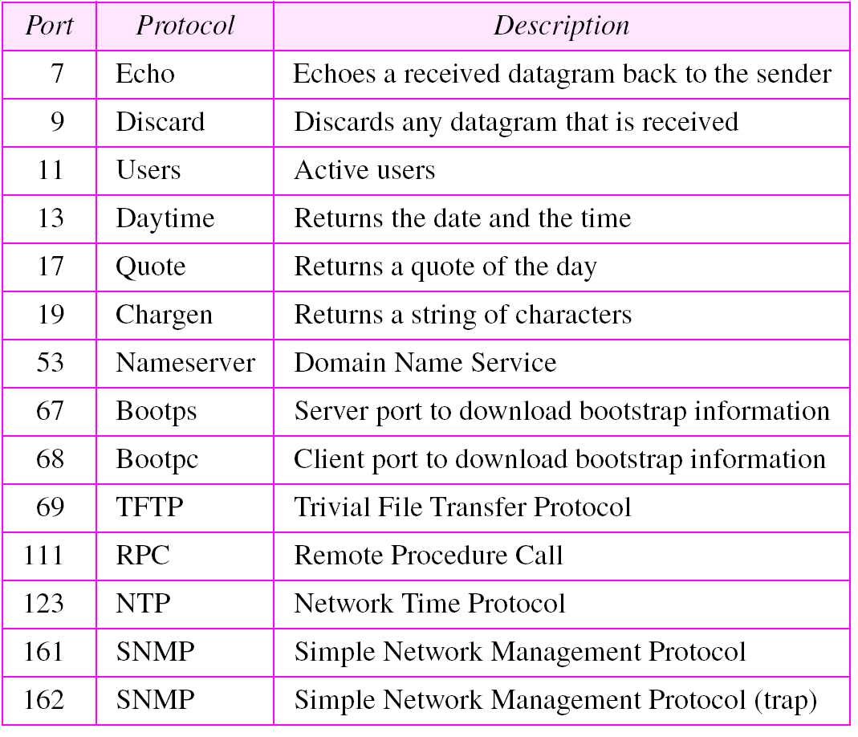
UDP Port addresses
Well-known & Registered ports SHOULD NOT be used without IANA (Internet Assigned Numbers Authority) registration. The registration procedure is defined in [RFC4340]

Slide 16
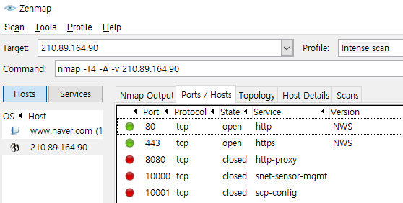
Activity: nmap
https://nmap.org
Install MS Windows executable (install with Zenmap GUI)
  Latest release self-installer: nmap-7.80-setup.exe
For TCP, nmap sequentially scans ports, looking for ports that are accepting TCP connections.
For UDP, nmap again sequentially scans ports, looking for UDP ports that respond to transmitted UDP segments.
In both cases, nmap returns a list of open, closed, or unreachable ports. A host running nmap can attempt to scan any target host anywhere in the Internet.
Activities:
Nslookup your favorite Web servers
Set the Web server’s IP address as the target; and scan with Zenmap GUI
Observe “Ports/Hosts” tab
Scan one or more other Web servers.
Observe the other tabs
Discuss what you have found

Slide 17
Lab 04 UDP

Slide 18
Lab 04: UDP on Wireshark
Instructions
Start capturing packets in Wireshark.
Stop capturing packets.
Questions
Select one UDP packet from your trace. From this packet, determine how many fields there are in the UDP header. Name these fields.
Find out the length (in bytes) of each of the UDP header fields.
The value in the Length field is the length of what? Verify your claim with your captured UDP packet.
What is the maximum number of bytes that can be included in a UDP payload? (Hint: the answer to this question can be determined by your answer to 2. above)
What is the largest possible source port number? (Hint: see the hint in 4.)
What is the protocol number for UDP? Give your answer in both hexadecimal and decimal notation. To answer this question, you’ll need to look into the Protocol field of the IP packet containing this UDP segment.
Examine a pair of UDP packets. (your host sends the first UDP packet and the second UDP packet is a reply to this first UDP packet.) (Hint: for a second packet to be sent in response to a first packet, the sender of the first packet should be the destination of the second packet). Describe the relationship between the port numbers in the two packets.

Slide 19
05-3. Transmission Control Protocol, TCP

Slide 20
05-3. TCP contents
Overview
TCP Connection management
TCP Error Control
TCP Flow Control
Congestion Control Overview
TCP Congestion Control

Slide 21
Basic Mechanisms for
Reliable Data Transfer
Sequence Number (for correct order)
  for sequential numbering of packets of data flowing from sender to receiver.
Checksum (for data integrity)
  to detect bit errors in a transmitted packet
Acknowledgement
  to tell the sender that a packet or set of packets has been received correctly.
Timer
  to timeout/ retransmit a packet, possibly because the packet (or its ACK) was lost within the channel

Slide 22
TCP: Overview RFCs: 793,1122,1323, 2018, 2581
point-to-point:
  one sender, one receiver
full duplex data:
  bi-directional data flow in same connection
reliable, in-order byte stream: (Error Control)
  no “message boundaries”
flow controlled:
  sender will not overflow receiver
congestion controlled:
  Network congestion is implicitly detected → reduce the transmission rate
  congestion control and flow control set “window size”
connection-oriented:
  handshaking (exchange of control msgs) initiates sender, receiver state before data exchange → assign send/receive buffers for each direction

Slide 23
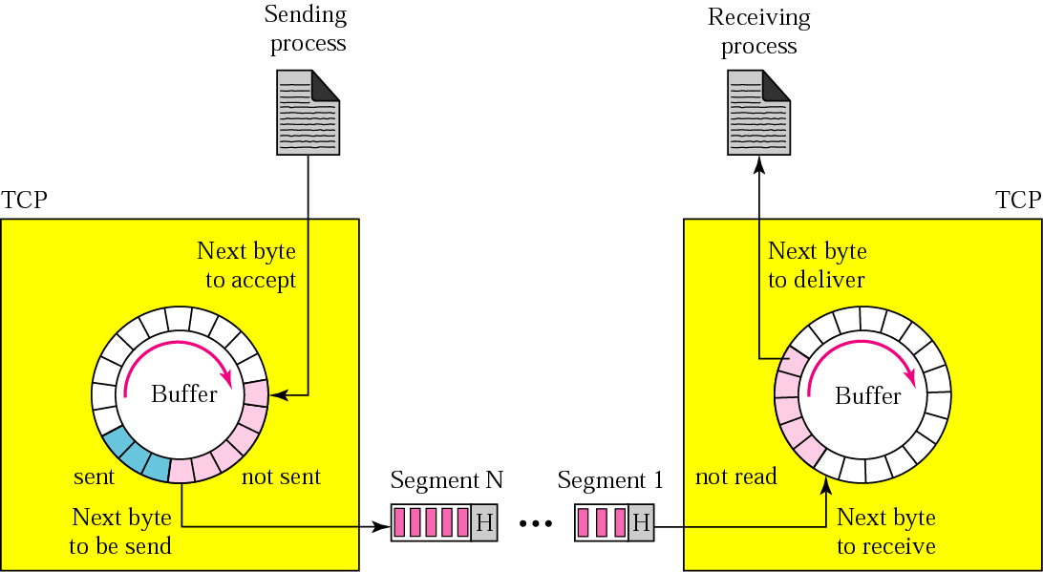
TCP buffers for “byte stream”
Between Application & TCP

Slide 24
Terminologies
Flow Control:
  Algorithms to prevent that the sender overflows the receiver with data
Congestion Control:
  Algorithms to prevent that the sender overloads the network
Error Control:
  Algorithms to recover or conceal the effects from packet losses
The goal of each of the control mechanisms is different.
But the implementation is combined

Slide 25
Remark: Data link control
Data link control = flow control + error control
  Performed at the Data Link Layer (Layer 2)
  based on automatic repeat request (ARQ), which is the mechanism for data retransmission
    ARQ is aimed mostly for Error control. Flow control can be implicitly achieved by not replying with ACK.
  ACK, NAK(Negative ACK), Piggybacking (ACKs and NAKs in data frames) are used for both controls at the same time.

Slide 26

TCP segment structure

Slide 27


Deliver the current segment before any buffered segments
Push the current segment regardless of TX buffer occupancy

Slide 28
More on flags
Flags for TCP connection
  SYN - Initiates a connection
  ACK - Acknowledges received data
  FIN - Closes a connection
  RST - Aborts a connection in response to an error
Push
  The sending application informs TCP that data should be sent immediately regardless of current TX buffer occupancy.
  The PSH flag in the TCP header informs the receiving host that the data should be pushed up to the receiving application immediately.
  TCP가 데이터를 app으로 올려 보내기 전에 버퍼가 가득 찰 때까지 기다리는 것을 방지
URG Pointer
  This pointer indicates how much of the data in the segment, counting from the first byte, is urgent.
  Not commonly used (RFC6093에 의해 사용되지 않도록 권고되었음)

Slide 29
TCP segment structure
sequence numbers:
  byte stream “number” of first byte in segment’s data
acknowledgements:
  seq # of next byte expected from the other side
  cumulative ACK
Q: how receiver handles out-of-order segments
  A: TCP spec doesn’t say, - it is up to the implementer. But usually TCP reorders the segments and delivers the ordered message to the process.

Slide 30
TCP Numbering system
Sequence number and Ack number are the byte number, not the segment number.
TCP generates a random number between 0 and 2³²-1 for the number of the first byte.
Example
  A TCP connection is transferring a file of 5000 bytes.
  The first byte is numbered 1057.
  We send five segments, each carrying 1000 bytes.
  What are the sequence numbers of five segments?

Slide 31
Example
How big can be a file for the TCP can handle without exhausting the Sequence number? TCP Seq number field has 4 bytes. Assume MSS is 512bytes.
Answer
There are 2³²=4,294,967,296 possible sequence numbers.
The sequence number does not increment by one with each segment. Rather, it increments by the number of bytes of data sent. So the size of the MSS is irrelevant.
The maximum size file that can be sent is simply the number of bytes representable by 2³² ~ 4.2Gbytes.

Slide 32
TCP contents
Overview
TCP Connection management
TCP Error Control
TCP Window Control for Flow Control & Congestion Control
Principles of Congestion Control
TCP Congestion Control in detail

Slide 33



Agreeing to establish a connection
2-way handshake:
Q: will 2-way handshake always work in network?
segment loss
→ retransmitted messages (e.g. req_conn(x))
variable delays
→ message misunderstanding
Let’s talk
ESTAB
OK
ESTAB
choose x
req_conn(x)
ESTAB
acc_conn(x)
ESTAB
<number><number>

Slide 34

Agreeing to establish a connection
2-way handshake failure scenarios:
choose x
choose x
req_conn(x)
req_conn(x)
ESTAB
ESTAB
retransmit
req_conn(x)
acc_conn(x)
retransmit
req_conn(x)
acc_conn(x)
ESTAB
ESTAB
data(x+1)
accept
data(x+1)
req_conn(x)
retransmit
data(x+1)
connection
x completes
connection
x completes
client terminates
server
forgets x
client terminates
server
forgets x
req_conn(x)
ESTAB
data(x+1)
ESTAB
half open connection
(no client)
accept
data(x+1)
<number><number>

Slide 35
TCP 3-way handshake
client state
server state
LISTEN
LISTEN
choose init seq num, x
send TCP SYN msg
SYNSENT
SYNbit=1, Seq=x
choose init seq num, y
send TCP SYNACK
msg, acking SYN
SYN RCVD
SYNbit=1, Seq=y
ACKbit=1; ACKnum=x+1
received SYNACK(x)
indicates server is live;
send ACK for SYNACK;
this segment may contain
client-to-server data
ESTAB
ACKbit=1, ACKnum=y+1
received ACK(y)
indicates client is live
ESTAB
<number><number>

Slide 36

Connection establishment using three-way handshaking
A SYN segment cannot carry data, but it consumes one sequence number.

Slide 37

Data transfer

Slide 38
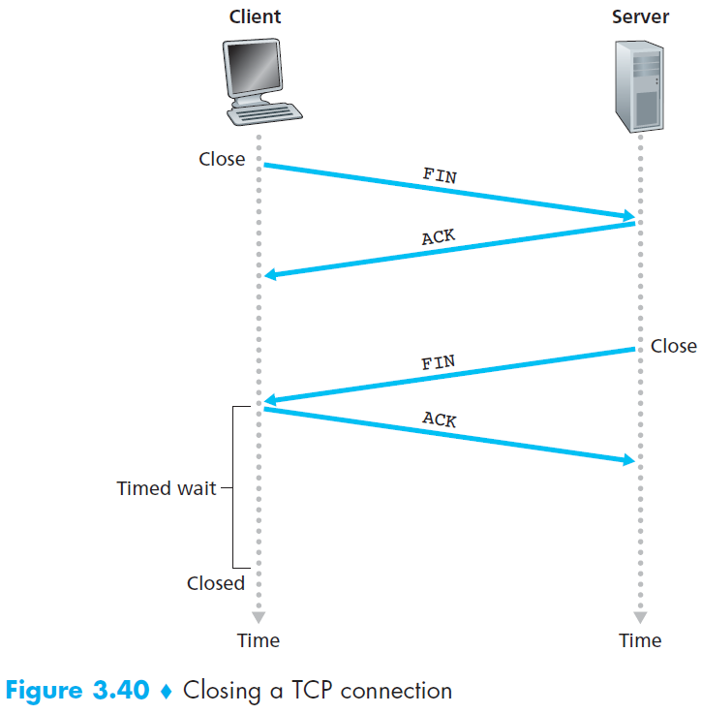
Connection termination using three-way handshaking

Slide 39
TCP contents
Overview
TCP Connection management
TCP Error Control
TCP Window Control for Flow Control & Congestion Control
Principles of Congestion Control
TCP Congestion Control in detail

Slide 40

Basic error control: Stop-and-Wait ARQ
What if a frame is lost or corrupted?
  Receiver does not send ACK.
  After some time, the sender sends the frame again
What if an ACK is lost?
  Send the frame again → but how does the Receiver knows the frame is resent? → Answer: Put an identifier at Data frame & ACK.

Slide 41

Stop-and-Wait ARQ:
Example
Request to Send 1

Slide 42
Stop-and-Wait ARQ
What is the max data rate (without error)?
  It depends on Round Trip Time (RTT), Frame length, etc.
How can you speed up the Stop-and-Wait?
Pipelining
  Send many frames
  without ACK
  Then wait for ACK

Slide 43
Go-Back-N ARQ
Pipelining improves the efficiency of the transmission
In the Go-Back-N Protocol, the sequence numbers are modulo 2^{m}, where m is the size of the sequence number field in bits
The send window is an abstract concept defining an imaginary box of size 2^{m} − 1 with three variables: S_{f}, S_{n}, and S_{size}
  For example, if m=4, then the maximum number of frames sent without ACK is 2⁴ − 1 = 15

Slide 44

Go-Back-N ARQ Example
What if we send ACK once in a while?

Slide 45

Go-Back-N ARQ Send window
The send window can slide one or more slots when a valid acknowledgment arrives.
Why can’t we send 15?

Slide 46

Go-Back-N ARQ Receive window
The receive window is an abstract concept defining an imaginary box of size 1 with one single variable R_{n}. The window slides when a correct frame has arrived; sliding occurs one slot at a time.

Slide 47

Why Window Size < 2^{m}

Slide 48
Note on window size & sequence number space
Worst case happens when all the frames are sent, all the ACKs are sent but dropped.
The sequence number space must be large enough to fit the entire receiver window and the entire sender window.
Send window size + Receive window size ≤ Sequence number space size

Slide 49
TCP Error control
Based mostly on Go-back-N ARQ
  Detects loss from timeout
  Retransmits from lost packet onward
  does not use NAK
Go-back-N과 다른 점
  The receiver holds the out-of-order segments until the missing ones arrive
  ACKs are cumulative
  TCP uses byte-oriented numbering
  TCP Send window & Receive window are of variable size

Slide 50

Segment reordering in TCP

Slide 51
TCP round trip time, timeout
Q: how to set TCP timeout value?
longer than Round Trip Time (RTT)
  but RTT varies
too short: premature timeout, unnecessary retransmissions
too long: slow reaction to segment loss
Q: how to estimate RTT?
SampleRTT: measured time from segment transmission until ACK receipt
  ignore retransmissions
SampleRTT will vary, want estimated RTT “smoother”
  average several recent measurements, not just current SampleRTT

Slide 52
Question
Time-out period can be relatively long.
When a segment is lost, this long TO period makes the delay too long.
TCP does not use NAK.
How can we remedy this problem?
Answer: duplicate ACK
an ACK that re-acknowledges a segment for which the sender has already received an earlier acknowledgment
When a TCP receiver receives a segment with a sequence number that is larger than the next, expected, in-order sequence number, it re-acknowledges the last in-order byte of data it has received.

Slide 53

Fast retransmission with
3 duplicate ACKs

Slide 54
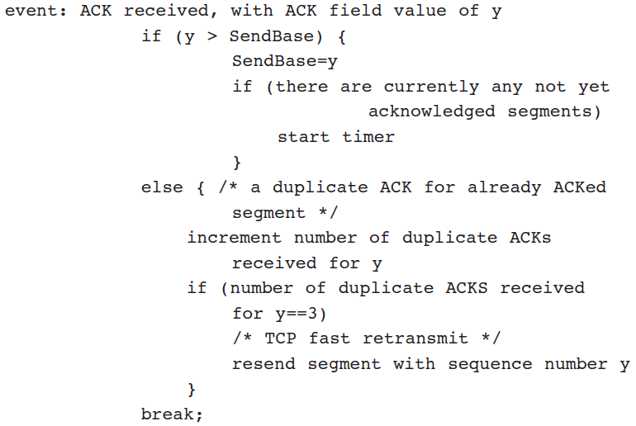
Fast retransmission with
3 duplicated ACKs
Modified Sender’s reaction to ACK

Slide 55
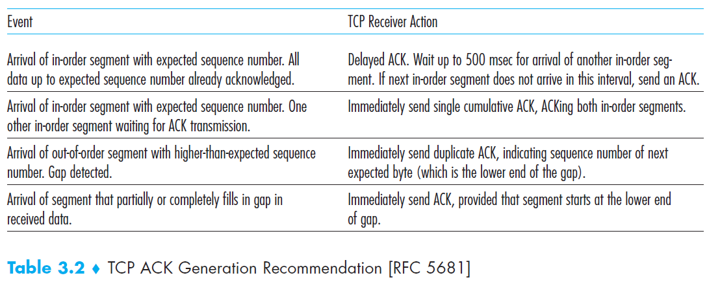
TCP ACK Generation

Slide 56
TCP contents
Overview
TCP Connection management
TCP Error Control
TCP Window Control for Flow Control & Congestion Control
Principles of Congestion Control
TCP Congestion Control in detail

Slide 57
Transmission Rate Control with a window
RTT
Source
1
2
W
1
2
W
time
data
ACKs
Destination
1
2
W
1
2
W
time
~ W packets per RTT
Lost packet detected by missing ACK

Slide 58
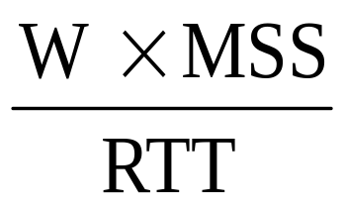
Transmission Rate Control with a window - continued
Limit the number of packets in the network to window size W
Trassmission rate = bps
  MSS: Max Segment Size, RTT: Round trip time
If W too small then (Transmission rate « network capacity)
If W too big then rate > capacity
=> congestion
Adapt W to network (and conditions)

Slide 59
TCP Window Controls Summary
Flow control
  Avoid overloading receiver
  Set by receiver
  rwnd: receive (advertised) window
Congestion control
  Avoid overloading network
  Set by sender
  Infer available network capacity
  cwnd: congestion window
Set W = min (cwnd, rwnd)

Slide 60
Flow Control
receiver “advertises” free buffer space by including rwnd value in TCP header of receiver-to-sender segments
  RcvBuffer size set via socket options
    typical default is 4096 bytes
  many operating systems auto adjust RcvBuffer
sender limits amount of unacked (“in-flight”, LastByteSent – LastByteAcked) data to receiver’s rwnd value
guarantees receive buffer will not overflow
to application process
RcvBuffer
buffered data
rwnd
free buffer space
TCP segment payloads
receiver-side buffering

Slide 61
Congestion control
Source calculates cwnd from indication of network congestion
Congestion indications used in general
  Losses (in case of TCP)
  Delay
  Marks
Algorithms to calculate cwnd
  Various versions: TCP Tahoe, TCP Reno, TCP Vegas, RED, REM …

Slide 62

TCP Sliding window
A sliding window for both flow control & congestion control.
The size of the window is the min of rwnd and cwnd.
The source does not have to send a full window’s worth of data.
The window can be opened (by increasing window size) or closed (by ACK) by the receiver, but should not be shrunk.
TCP sliding windows are byte-oriented.

Slide 63
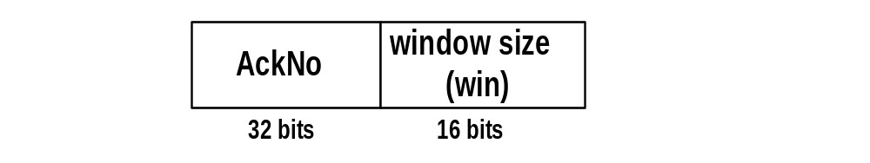
Window Management in TCP
The receiver is returning two parameters to the sender
The interpretation is:
    I am ready to receive new data with
    SeqNo= AckNo, AckNo+1, …., AckNo+win-1
Receiver can acknowledge data without opening the window → Closing
Receiver can change the window size without acknowledging data → Opening or Shrinking

Slide 64
Lab 05 TCP

Slide 65
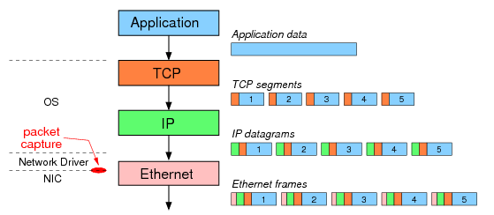
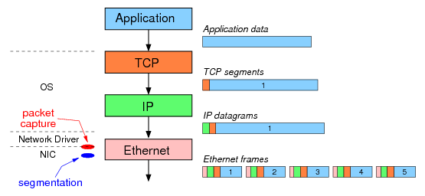
TCP Large Segment Offloading (TSO)
PC without TSO option
PC with TSO option
The result: although the same 5 Ethernet frames are sent over the network, Wireshark captures different data depending on the use of segmentation offloading.

Slide 66
Instructions
Start up your web browser. Go the http://gaia.cs.umass.edu/wiresharklabs/alice.txt and retrieve an ASCII copy of Alice in Wonderland. Store this file somewhere on your computer.
Next go to http://gaia.cs.umass.edu/wireshark-labs/TCP-wireshark-file1.html.
Use the ‘Browse’ button to enter the name of the file (full path name) on your computer containing Alice in Wonderland (or do so manually). Don’t yet press the “Upload alice.txt file” button.
Now start up Wireshark and begin packet capture (Capture->Start) and then press OK on the Wireshark Packet Capture Options screen (we’ll not need to select any options here).
Returning to your browser, press the “Upload alice.txt file” button to upload the file to the gaia.cs.umass.edu server. Once the file has been uploaded, a short congratulations message will be displayed in your browser window.
Stop Wireshark packet capture.
Filter the packets displayed in the Wireshark window by entering “tcp” (lowercase)

Slide 67
Questions (Part 1/4)
What is the IP address and TCP port number used by the client computer (source) that is transferring the file to gaia.cs.umass.edu?
What is the IP address of gaia.cs.umass.edu? On what port number is it sending and receiving TCP segments for this connection?

Slide 68

Questions (Part 2/4)
What is the sequence number of the TCP SYN segment that is used to initiate the TCP connection between the client computer and gaia.cs.umass.edu? What is it in the segment that identifies the segment as a SYN segment?
What is the sequence number of the SYNACK segment sent by gaia.cs.umass.edu to the client computer in reply to the SYN? What is the value of the Acknowledgement field in the SYNACK segment? How did gaia.cs.umass.edu determine that value? What is it in the segment that identifies the segment as a SYNACK segment?
What is the sequence number of the TCP segment containing the HTTP POST command? Note that in order to find the POST command, you’ll need to dig into the packet content field at the bottom of the Wireshark window, looking for a segment with a “POST” within its DATA field.

Slide 69
Questions (Part 3/4)
Consider the TCP segment containing the HTTP POST as the first segment in the TCP connection.
  What are the sequence numbers of the first six segments in the TCP connection (including the segment containing the HTTP POST)?
  At what time was each segment sent? When was the ACK for each segment received?
  Given the difference between when each TCP segment was sent, and when its acknowledgement was received, what is the RTT value for each of the six segments?
  Note: Wireshark has a nice feature that allows you to plot the RTT for each of the TCP segments sent. Select a TCP segment in the “listing of captured packets” window that is being sent from the client to the gaia.cs.umass.edu server. Then select: Statistics->TCP Stream Graph->Round Trip Time Graph.

Slide 70
Questions (Part 4/4)
What is the length of each of the first six TCP segments?
What is the minimum amount of available buffer space advertised at the received for the entire trace? Does the lack of receiver buffer space ever throttle(차단 혹은 전송 rate 감소) the sender?
Are there any retransmitted segments in the trace file? What did you check for (in the trace) in order to answer this question?
How much data does the receiver typically acknowledge in an ACK? Can you identify cases where the receiver is ACKing every other received segment (see the table on next page).
What is the throughput (bytes transferred per unit time) for the TCP connection? Explain how you calculated this value.

Slide 71
TCP ACK generation
[RFC 1122, RFC 2581, RFC5681]
event at receiver
arrival of in-order segment with
expected seq #. All data up to
expected seq # already ACKed
arrival of in-order segment with
expected seq #. One other
segment has ACK pending
arrival of out-of-order segment
higher-than-expect seq. # .
Gap detected
arrival of segment that
partially or completely fills gap
TCP receiver action
delayed ACK. Wait up to 500ms
for next segment. If no next segment,
send ACK
immediately send single cumulative
ACK, ACKing both in-order segments
immediately send duplicate ACK,
indicating seq. # of next expected byte
immediate send ACK, provided that
segment starts at lower end of gap

